Slide 1

Smart Deploy

Slide 2
OBJECTIVES
Required Use case
Project Understanding
Technology
MVP
Modules
Learning
Screenshots

Slide 3
Use Case
Demand Reporting feature will give Resource Managers or Demand Managers a view to see all demands that are raised in the system and analyses them based on different parameters.
Report should be filtered on parameters like dates (from and to).
After selecting necessary filters, pie chart should appear showing number of demands raised vs number of demands fulfilled.
On click of chart, a table should open in a dialog box and fields should be filterable, searchable and sortable on various fields like demand skills, grade, completion date.
Report should be downloadable in excel format after necessary filters are selected.

Slide 4
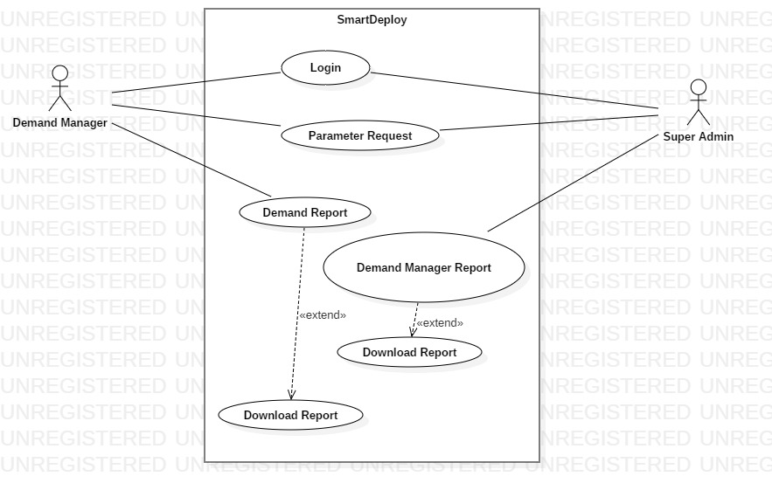
Use Case Diagram

Slide 5
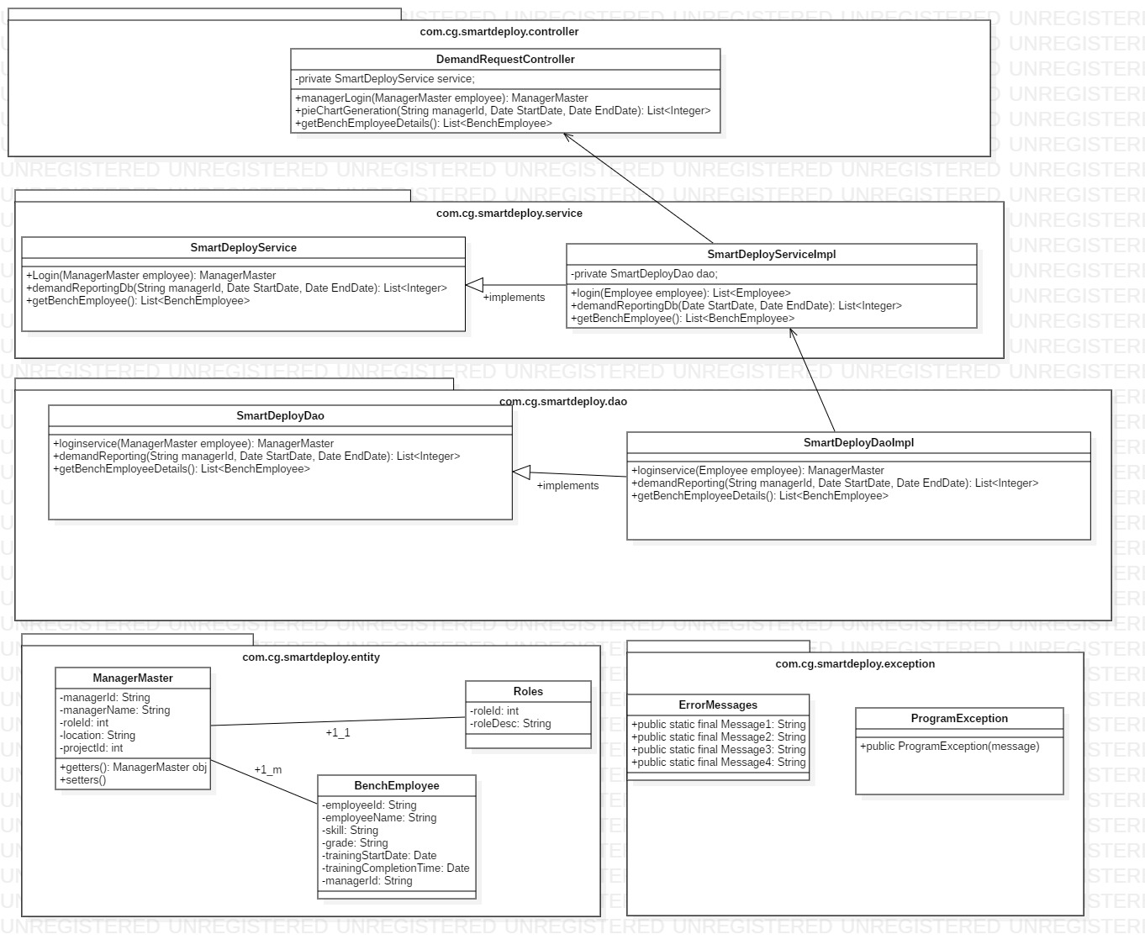

Slide 6
Block Diagram
Spring Boot
My SQL
Angular
UI
Controller & Services
Database

Slide 7
PROJECT UNDERSTANDING
The main objective of this project is to provide the user the demand report where he can see all the demands raised and demands fulfilled.
The issues and bug report information will be maintained in oracle JDBC database.
Based on the type of application that has been selected, the report will be generated and prompts the user whether they have to proceed or not before submission.

Slide 8
Technology
1)Front End & Web Components:
Angular – 8,High charts , Ngx-Bootstrap , ag-Grid, ng-Prime
2) Business Logic Components And Services:
Spring Boot Version 4.0
3)Database:
MYSQL
4)Application Server:
Tomcat 9.0

Slide 9
MVP 1
PRODUCT | START DATE | END DATE | RESPONSIBLE
Test case plan | 08-08-19 | 08-08-19 | Bharathi
Use case diagram,class diagram | 08-08-19 | 08-08-19 | Yogendra Sharma,Rathore
Pie Chart development | 08-08-19 | 08-08-19 | Jyothi
Connecting to the database | 09-08-19 | 10-08-19 | Yogendra Sharma
Sequence Diagram | 08-08-19 | 08-08-19 | Rifat Bano
Deployment | 09-08-19 | 10-08-19 | Bharathi
Spring boot coding | 08-08-19 | 10-08-19 | Rathore

Slide 10
MVP 2
MVP2 | START DATE | END DATE | RESPONSIBLE
Mapping the database with tables and retrieweng required data | 10-08-19 | 12-08-19 | Yogendra Sharma,Jyothi
Completing the service code | 10-08-19 | 12-08-19 | Rathore
Test Cases | 11-08-19 | 12-08-19 | Bharathi
Deployment | 12-08-19 | 12-08-19 | Rifat Bano

Slide 11
MODULES
Login Module
Demand Manager Module
Super Admin Module

Slide 12
Login Module
This module comprises of parameters like
Start Date
End Date
The demand manager will be logging in by giving a range of date

Slide 13
Demand Manager Module
This module comprises of factors like:
Pie Chart Designing-which displays the demands raised and demands fulfilled.
Preparing filterable , sortable, searchable tables-which results the desired data of the user.

Slide 14
Super Admin Module
This module includes:
Displaying the data related to a particular demand manager
Final deployment of the project to the cloud

Slide 15
Learning
Code Reviewing using PMD, which is a source code review/analyzer tool which helps the execution of code smoothly by finding bugs in our code.
Usage of a new database called POSTGRESQL to maintain the data regarding the analyzed report of types of applications that has already been on boarded through Jenkins.

Slide 16
THANK YOU
Mentor-Tanmaya Acharya
Team 3

